Slide 1
A core Course on Modeling
Introduction to Modeling
0LAB0 0LBB0 0LCB0 0LDB0
c.w.a.m.v.overveld@tue.nl
v.a.j.borghuis@tue.nl
S.5

Slide 2
define
context → initial problem
conceptualize
initial problem → conceptual model
formalize
conceptual model → formal model
execute
formal model → result
conclude
result → resolve initial problem?
Notes:
2

Slide 3
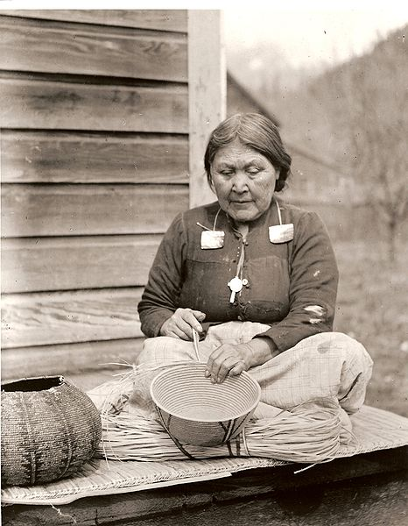
3
define
conceptualize
http://commons.wikimedia.org/wiki/File:Stolo_woman_with_cedar_basket.jpg
formalize
sometimes, all modeling phases may be skipped
execute
conclude
Notes:
3

Slide 4
define
conceptualize
formalize
sometimes, the formal phases may be skipped
execute
conclude
http://commons.wikimedia.org/wiki/File:Crystal_Clear_app_starthere.png
Notes:
4
A geographic map and/or a compass are examples of conceptual models that may help to solve problems without further need for formal manipulations.

Slide 5
QUIZ
A map and compass form a (material) model of a piece of terrain, serving the purpose ‘decision making’ without need for a formal model.
Give another example.
define
conceptualize
formalize
sometimes, the formal phases may be skipped
execute
conclude
Notes:
5
A geographic map and/or a compass are examples of conceptual models that may help to solve problems without further need for formal manipulations.

Slide 6
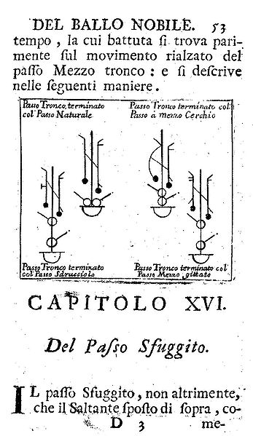
define
conceptualize
http://commons.wikimedia.org/wiki/File:Dufort_1728.JPG
formalize
sometimes, the formal phases may be skipped
execute
conclude
Notes:
6
A geographic map and/or a compass are examples of conceptual models that may help to solve problems without further need for formal manipulations.

Slide 7
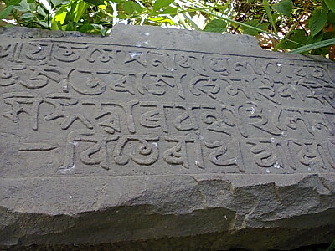
define
formulate
purpose
conceptualize
formalize
execute
conclude
http://commons.wikimedia.org/wiki/File:Treaty.jpg
Notes:
7
Negotiate with problem owner; reach explicit agreement
What problem are we solving?
What context?
What purpose?
What will be done with the results?

Slide 8
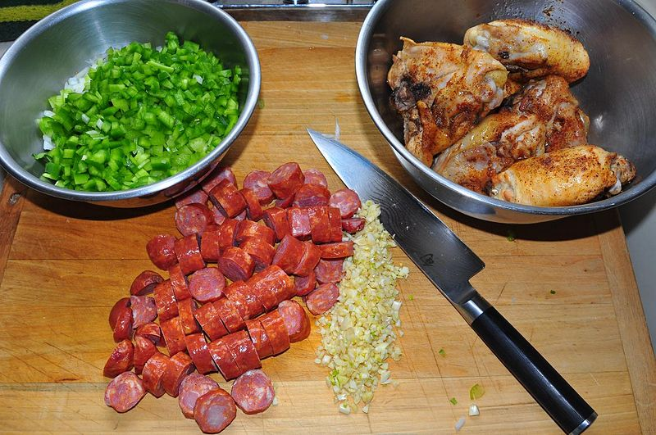
define
formulate
purpose
conceptualize
identify
entities
formalize
execute
conclude
http://commons.wikimedia.org/wiki/File:Main_ingredients_(4185442972).jpg
Notes:
8
What entities do we consider?
What properties do we have per entity?

Slide 9
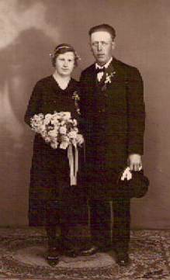
9
define
formulate
purpose
conceptualize
identify
entities
choose
relations
http://commons.wikimedia.org/wiki/File:Mariage_finitzer_1935.jpg
formalize
execute
conclude
Notes:
9
What qualitative relations do these entities have?

Slide 10
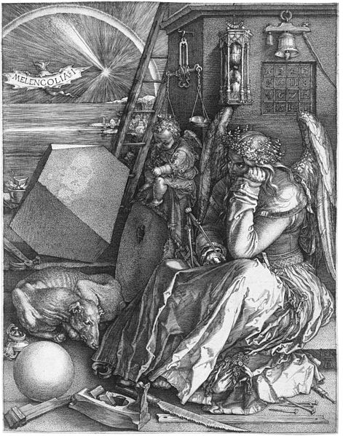
10
define
formulate
purpose
conceptualize
identify
entities
choose
relations
http://commons.wikimedia.org/wiki/File:D%C3%BCrer_Melancholia_I.jpg
obtain
values
formalize
execute
conclude
Notes:
10
Which properties have known values (and which not)?
How do we obtain (measure?) the required values?
Which properties do we need to know

Slide 11
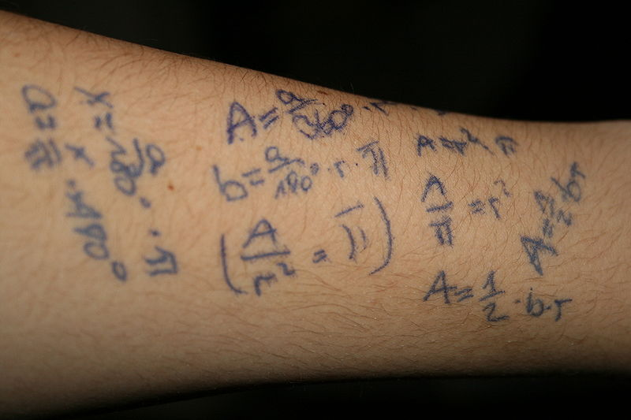
11
define
formulate
purpose
conceptualize
identify
entities
choose
relations
obtain
values
formalize
relations
formalize
execute
conclude
http://commons.wikimedia.org/wiki/File:Mathematical_formulas.JPG
Notes:
11
How do translate relations to formal relations?

Slide 12
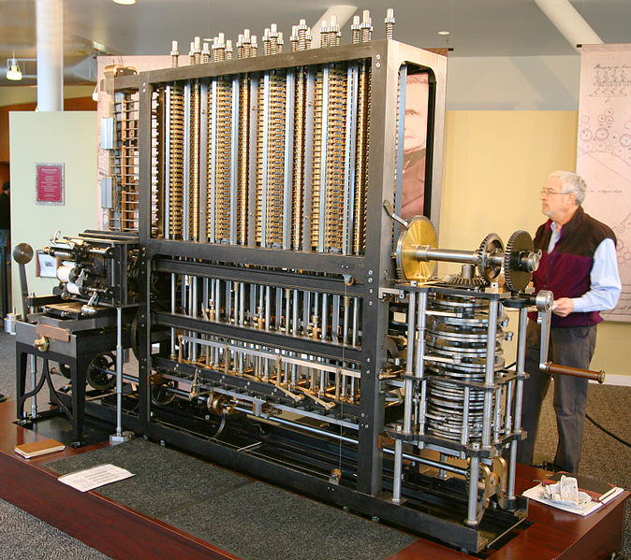
12
define
formulate
purpose
conceptualize
identify
entities
choose
relations
obtain
values
formalize
relations
formalize
execute
operate
model
conclude
http://commons.wikimedia.org/wiki/File:Babbage_Difference_Engine_(the_power-supply_end).jpg
Notes:
12
What can we / must we do with the model?
How can we do that?

Slide 13
13
define
formulate
purpose
conceptualize
identify
entities
choose
relations
http://commons.wikimedia.org/wiki/File:Bruxelles_Grand-place_1_901.jpg
obtain
values
formalize
relations
formalize
execute
operate
model
obtain
result
conclude
Notes:
13
What result do we get out?

Slide 14
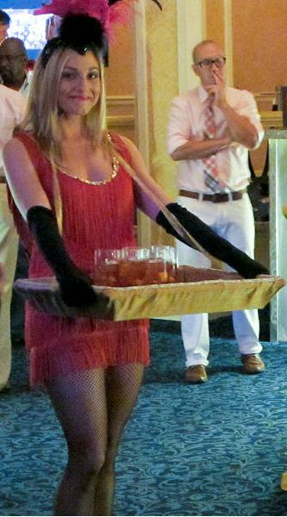
14
define
formulate
purpose
conceptualize
identify
entities
choose
relations
http://commons.wikimedia.org/wiki/File:Drambuie_VIP_Party_Waitress_at_The_Roosevelt_cropped.jpg
obtain
values
formalize
relations
formalize
execute
operate
model
obtain
result
present
result
conclude
Notes:
14
In which context should we present the result?
What presentation is appropriate?

Slide 15
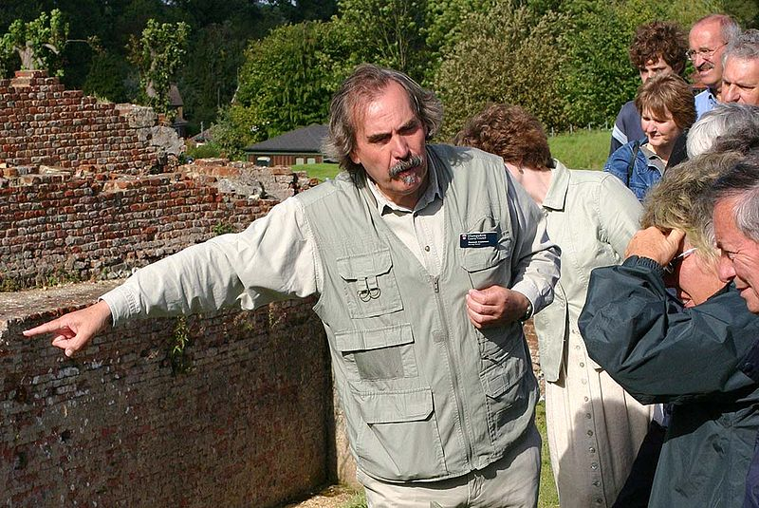
15
define
formulate
purpose
conceptualize
identify
entities
choose
relations
obtain
values
formalize
relations
formalize
execute
operate
model
obtain
result
present
result
interpret
result
conclude
http://commons.wikimedia.org/wiki/File:Tour_Guide.jpg
Notes:
15
In which context should we present the result?
What presentation is appropriate?
What does the result mean?
What further conclusions can we draw from it?

Slide 16
define
formulate
purpose
conceptualize
identify
entities
choose
relations
obtain
values
formalize
relations
formalize
execute
operate
model
obtain
result
r e f l e c t i o n
present
result
interpret
result
conclude
http://commons.wikimedia.org/wiki/File:CA_Fan_Palms_Reflect_in_Lake_Tuendae.jpg
Notes:
16

Slide 17
define
formulate
purpose
Right problem?
(problem validation)
conceptualize
identify
entities
choose
relations
obtain
values
formalize
relations
formalize
execute
operate
model
obtain
result
present
result
interpret
result
conclude
Notes:
17

Slide 18
define
formulate
purpose
Right problem?
(problem validation)
conceptualize
identify
entities
choose
relations
Right concepts?
(concepts validation)
obtain
values
formalize
relations
formalize
execute
operate
model
obtain
result
present
result
interpret
result
conclude
Notes:
18

Slide 19
define
formulate
purpose
Right problem?
(problem validation)
conceptualize
identify
entities
choose
relations
Right concepts?
(concepts validation)
obtain
values
formalize
relations
Right model?
(model verification)
formalize
execute
operate
model
obtain
result
present
result
interpret
result
conclude
Notes:
19

Slide 20
define
formulate
purpose
Right problem?
(problem validation)
conceptualize
identify
entities
choose
relations
Right concepts?
(concepts validation)
obtain
values
formalize
relations
Right model?
(model verification)
formalize
Right outcome?
(outcome verification)
execute
operate
model
obtain
result
present
result
interpret
result
conclude
Notes:
20

Slide 21
define
formulate
purpose
Right problem?
(problem validation)
conceptualize
identify
entities
choose
relations
Right concepts?
(concepts validation)
obtain
values
formalize
relations
Right model?
(model verification)
formalize
Right outcome?
(outcome verification)
execute
operate
model
obtain
result
Right answer?
(answer verification)
present
result
interpret
result
conclude
Notes:
21
Why is this relevant?

